Slide 1
Line Sizing
By Shardul Kulkarni

Slide 2
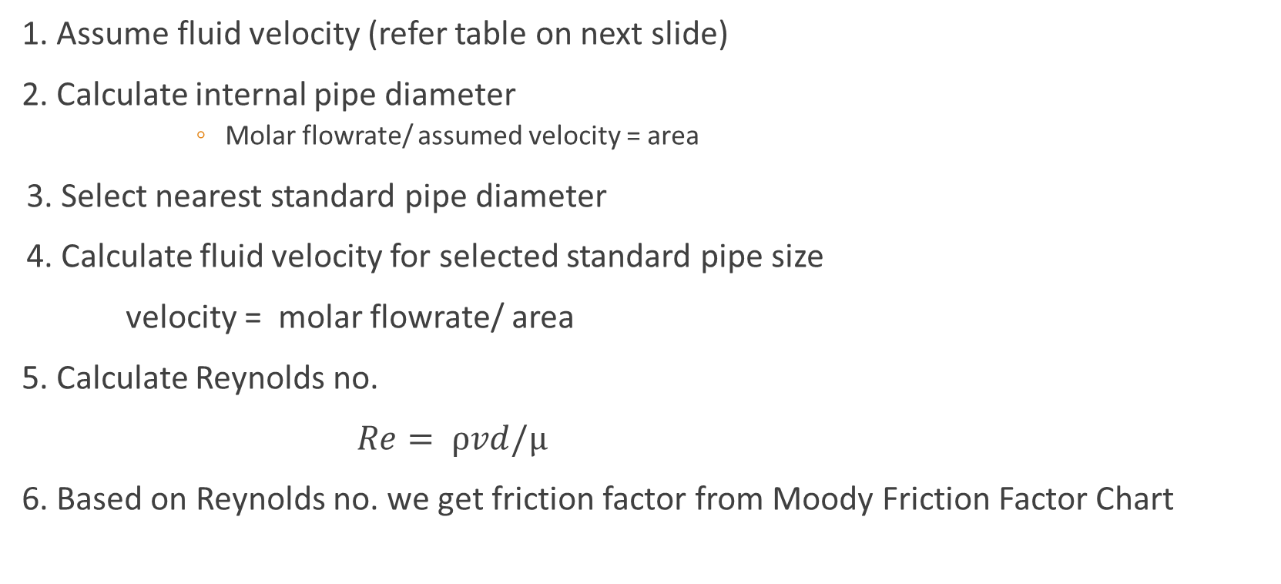
Steps
1. Assume fluid velocity (refer table on next slide)
2. Calculate internal pipe diameter
Molar flowrate/ assumed velocity = area
3. Select nearest standard pipe diameter
4. Calculate fluid velocity for selected standard pipe size
velocity = molar flowrate/ area
5. Calculate Reynolds no.
$Re= ρvd/µ$
6. Based on Reynolds no. we get friction factor from Moody Friction Factor Chart

Slide 3
FLUID |  | RECOMMENDED VELOCITY (m/s)
Water | Average service | 1 to 2.5
 | Pump suction line | 0.3 to 1.5
 | Pump discharge line | 2 to 3
Steam | Superheated below 10 atm | 20 to 50
 | Superheated above 10 atm | 30 to 75
 | Vacuum line | 100 to 125
Air | 0 to 2 atm g | 20
 | Above 2 atm g | 30
Oil & organic liquids |  | 1.8 to 2

Slide 4
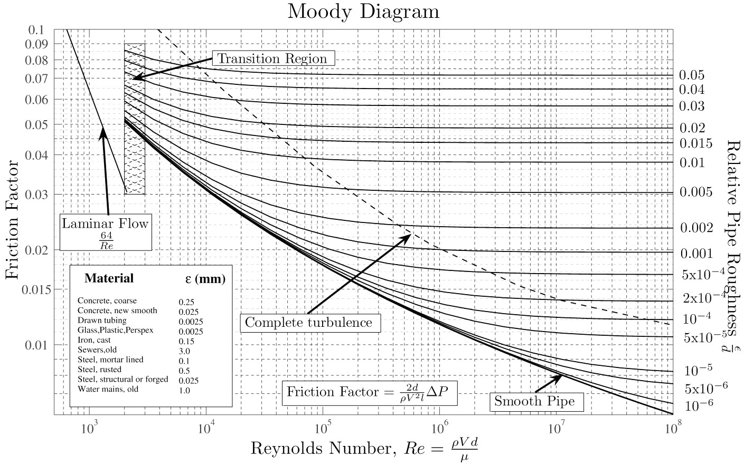

Slide 5
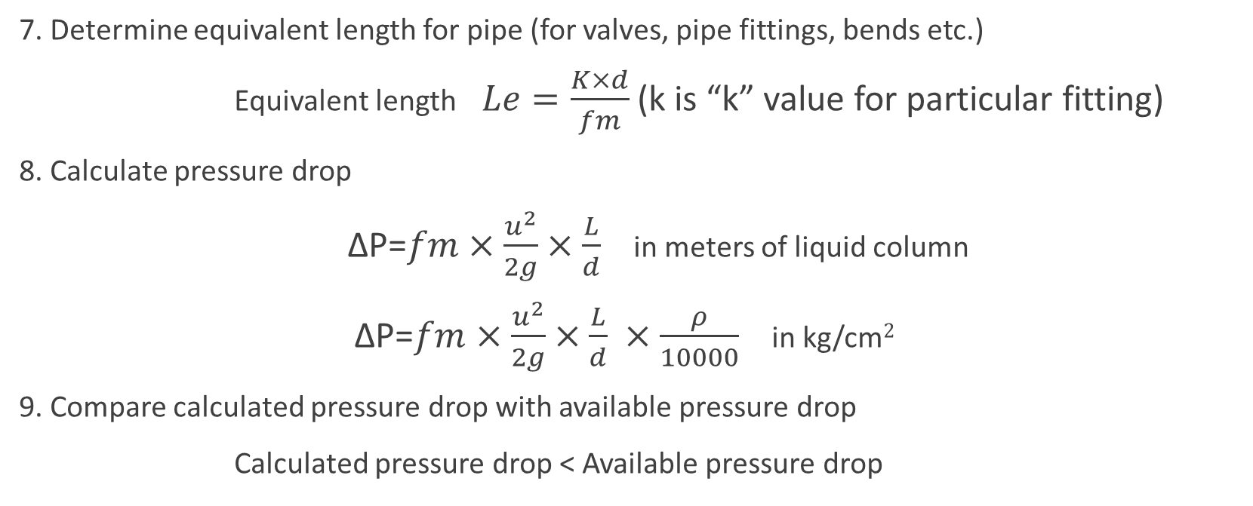
7. Determine equivalent length for pipe (for valves, pipe fittings, bends etc.)
Equivalent length $Le=\frac{K×d}{fm}$ (k is “k” value for particular fitting)
8. Calculate pressure drop
$\text{Δ}\text{P}$=$fm×\frac{u^{2}}{2g}×\frac{L}{d}$in meters of liquid column
$\text{Δ}\text{P}$=$fm×\frac{u^{2}}{2g}×\frac{L}{d} ×\frac{ρ}{10000}$ in kg/cm$2$
9. Compare calculated pressure drop with available pressure drop
Calculated pressure drop < Available pressure drop

Slide 6
THANK YOU.

